Slide 1

Cloud Platform as a Service for Java Web Apps
www.supinfo.com
Copyright © SUPINFO. All rights reserved
Notes:
© SUPINFO International University - http://www.supinfo.com
SUPINFO vous permet de partager ce document
Vous êtes libre de :
Partager — reproduire, distribuer et communiquer ce document Remixer — modifier ce document
A condition de respecter les règles suivantes :
Indication obligatoire de la paternité — Vous devez obligatoirement préciser l’origine « SUPINFO » du document au début de celui-ci de la même manière qu’indiqué par SUPINFO International University – Notamment en laissant obligatoirement la première et la dernière page du document, mais pas d'une manière qui suggérerait que SUPINFO International University vous soutiennent ou approuvent votre utilisation du document, surtout si vous le modifiez. Dans ce dernier cas, il vous faudra obligatoirement supprimer le texte « SUPINFO Official Document » en tête de page et préciser notamment la page indiquant votre identité et les modifications principales apportées.
En dehors de ces dispositions, aucune autre modification de la première et de la dernière page du document n’est autorisée.
NOTE IMPORTANTE : Ce document est mis à disposition selon le contrat CC-BY-NC-SA Creative Commons disponible en ligne http://creativecommons.org/licenses ou par courrier postal à Creative Commons, 171 Second Street, Suite 300, San Francisco, California 94105, USA modifié en ce sens que la première et la dernière page du document ne peuvent être supprimées en cas de reproduction, distribution, communication ou modification. Vous pouvez donc reproduire, remixer, arranger et adapter ce document à des fins non commerciales tant que vous respectez les règles de paternité et que les nouveaux documents sont protégés selon des termes identiques. Les autorisations au-delà du champ de cette licence peuvent être obtenues à support@supinfo.com.
© SUPINFO International University – EDUCINVEST - Rue Ducale, 29 - 1000 Brussels Belgium . www.supinfo.com

Slide 2


CloudBees
Course objectives
By completing this course, you will be able to :
Create and use a repository provided by CloudBees
Use Jenkins
Deploy your applications inside the clouds…
Notes:
[Title of the course]
Nov 8, 2008
Copyright © 2004-2005 NameOfTheOrganization. All rights reserved.
2

Slide 3

CloudBees
Course topics
Course’s plan
Introduction to the Cloud
RUN & DEV @ Cloud
CloudBees SDK
Notes:
[Title of the course]
Nov 8, 2008
Copyright © 2004-2005 NameOfTheOrganization. All rights reserved.
3

Slide 4

Introduction
CloudBees
Validation issues…

Slide 5

CloudBees
What is the Cloud?
“Cloud computing is on-demand access to virtualized IT resources that are housed outside of your own data center, shared by others, simple to use, paid for via subscription, and accessed over the Web.”
- John Foley, Information Week IaaS
Notes:
[Title of the course]
Nov 8, 2008
Copyright © 2004-2005 NameOfTheOrganization. All rights reserved.
5

Slide 6
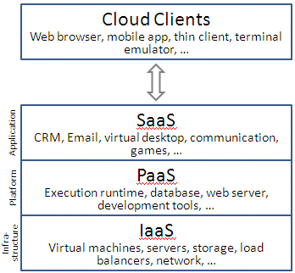
CloudBees
Introduction
Different types of Cloud services :
Notes:
[Title of the course]
Nov 8, 2008
Copyright © 2004-2005 NameOfTheOrganization. All rights reserved.
6

Slide 7
CloudBees
IaaS
Infrastructure as a Service
Most basic cloud service model
Cloud providers offer :
Computers (as physical or more often as virtual machines)
Raw (block) storage
Firewalls
Load balancers
Networks
Amazon is the most popular IaaS provider
Notes:
[Title of the course]
Nov 8, 2008
Copyright © 2004-2005 NameOfTheOrganization. All rights reserved.
7

Slide 8

CloudBees
IaaS
Developer point of view :
Flexible but very complicated
Have to manage :
Operating System
Application Server
Database
…
Notes:
[Title of the course]
Nov 8, 2008
Copyright © 2004-2005 NameOfTheOrganization. All rights reserved.
8

Slide 9

CloudBees
SaaS
Software as a Service
Cloud providers install and operate application software
No need to manage the cloud infrastructure and platform on which the application is running
What makes a cloud application different from other applications is its elasticity !
Can clone tasks onto multiple virtual machines at run-time to meet the changing work demand
Load balancers distribute the work over the set of virtual machines
The most popular example is SalesForce
Notes:
[Title of the course]
Nov 8, 2008
Copyright © 2004-2005 NameOfTheOrganization. All rights reserved.
9

Slide 10
CloudBees
PaaS
Platform as a Service
Cloud providers deliver a computing platform and/or solution stack
Operating System
Programming language execution environment
Database
Web server
…
No cost and complexity of buying and managing the underlying hardware and software layers
Notes:
[Title of the course]
Nov 8, 2008
Copyright © 2004-2005 NameOfTheOrganization. All rights reserved.
10

Slide 11



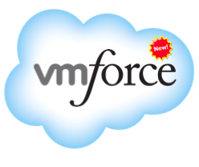

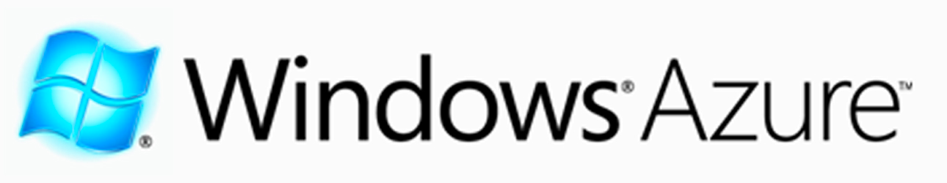
CloudBees
Famous PaaS providers
Notes:
[Title of the course]
Nov 8, 2008
Copyright © 2004-2005 NameOfTheOrganization. All rights reserved.
11

Slide 12

CloudBees
And…
Notes:
[Title of the course]
Nov 8, 2008
Copyright © 2004-2005 NameOfTheOrganization. All rights reserved.
12

Slide 13


CloudBees
Stop-and-think
Do you have any questions ?
Notes:
[Title of the course]
Nov 8, 2008
Copyright © 2004-2005 NameOfTheOrganization. All rights reserved.
13
13

Slide 14
DEV & RUN @ Cloud
CloudBees
A development and a production environment

Slide 15
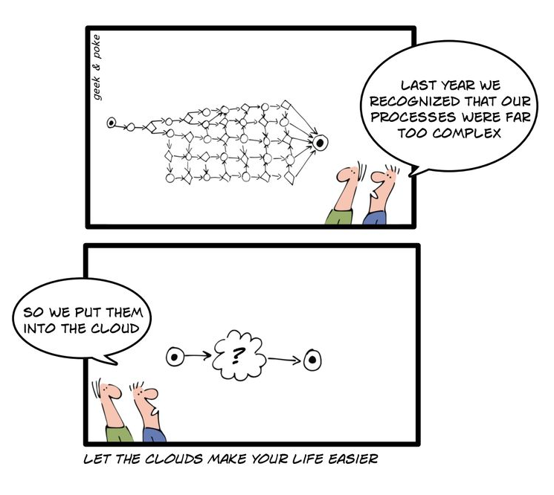
CloudBees
Geek & Poke
Notes:
[Title of the course]
Nov 8, 2008
Copyright © 2004-2005 NameOfTheOrganization. All rights reserved.
15

Slide 16
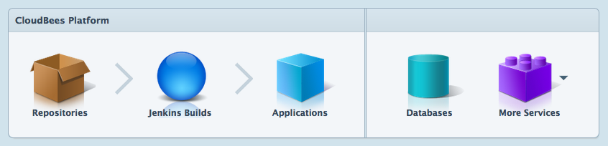
CloudBees
Introduction
CloudBees is a standards-based, integrated and scalable platform for Java developers
A leader in the Java Platform as a Service (PaaS) sector
Develop and deploy web applications in a cloud environment without administration headaches
DEV@Cloud
RUN@Cloud
Notes:
[Title of the course]
Nov 8, 2008
Copyright © 2004-2005 NameOfTheOrganization. All rights reserved.
16

Slide 17
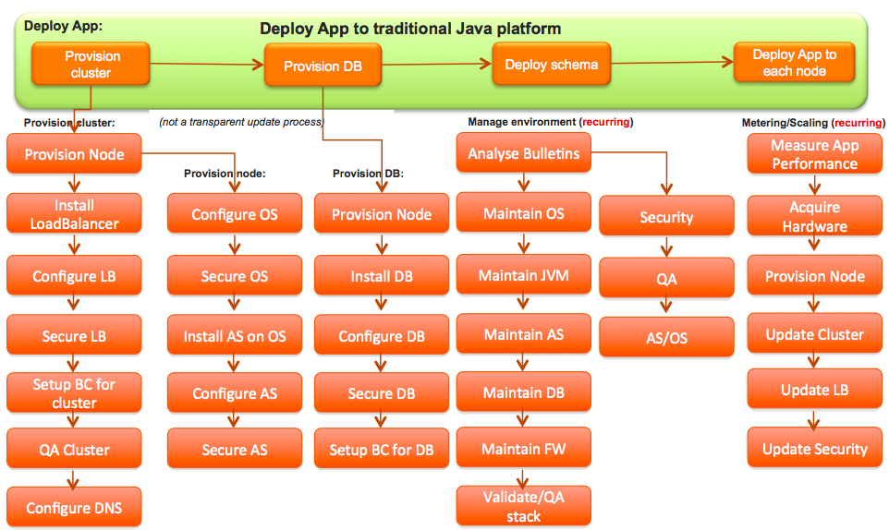
CloudBees
Classical deployment process
Notes:
[Title of the course]
Nov 8, 2008
Copyright © 2004-2005 NameOfTheOrganization. All rights reserved.
17

Slide 18
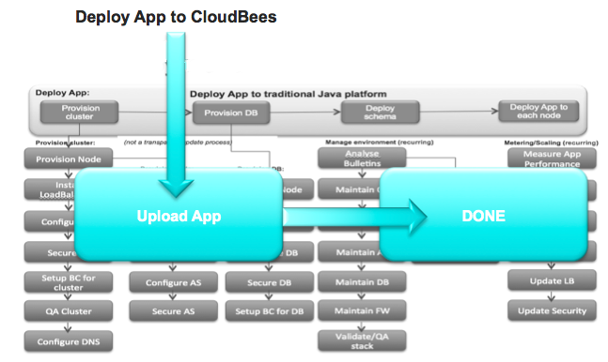
CloudBees
With CloudBees
Notes:
[Title of the course]
Nov 8, 2008
Copyright © 2004-2005 NameOfTheOrganization. All rights reserved.
18

Slide 19
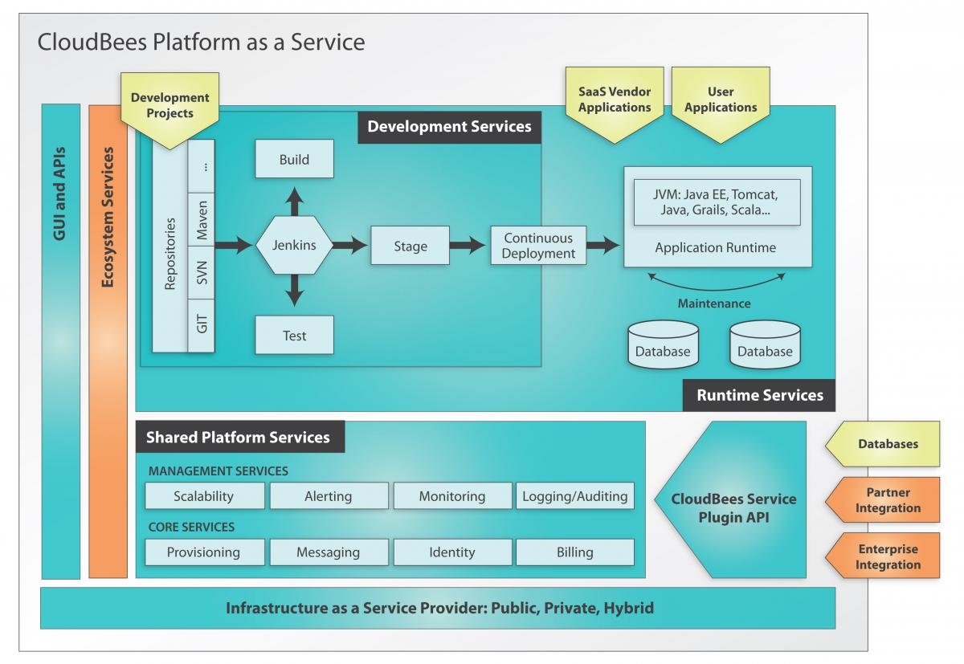
CloudBees
Introduction
Notes:
[Title of the course]
Nov 8, 2008
Copyright © 2004-2005 NameOfTheOrganization. All rights reserved.
19

Slide 20
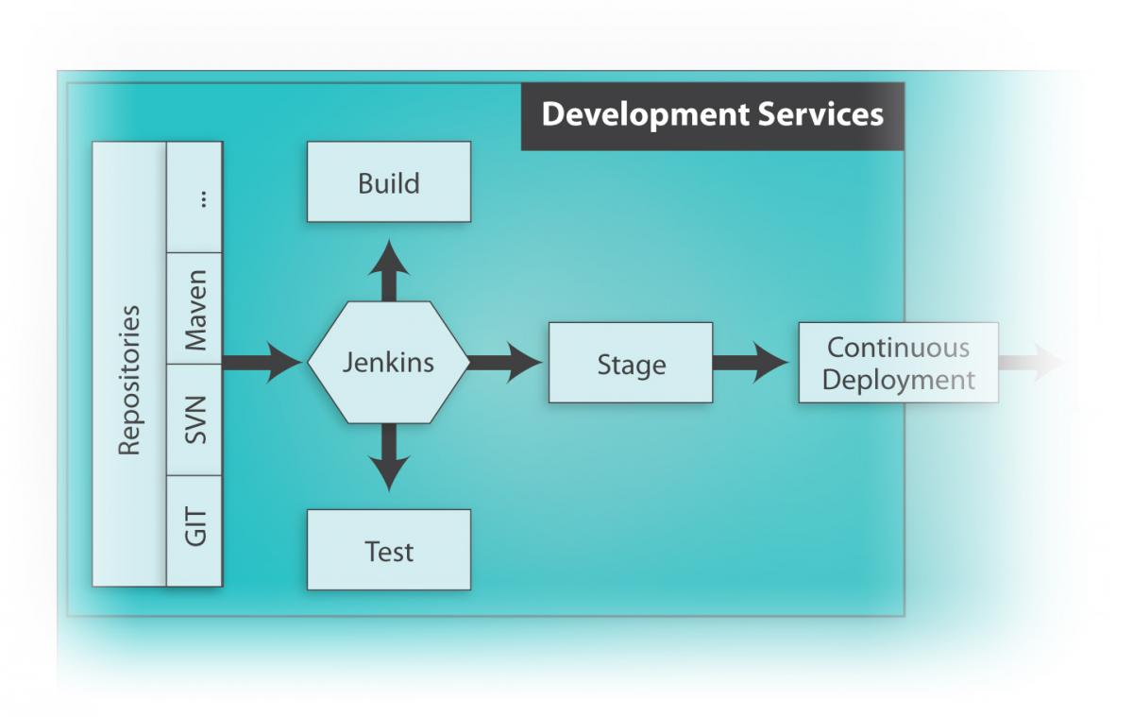
CloudBees
DEV@cloud
Provide a set of cloud-based development services
Solve the most common bottlenecks in the application development lifecycle
The core is the Jenkins Continuous Integration (CI) server
Notes:
[Title of the course]
Nov 8, 2008
Copyright © 2004-2005 NameOfTheOrganization. All rights reserved.
20
Jenkins is the most popular open source CI platform, with more than 25,000 sites deployed

Slide 21
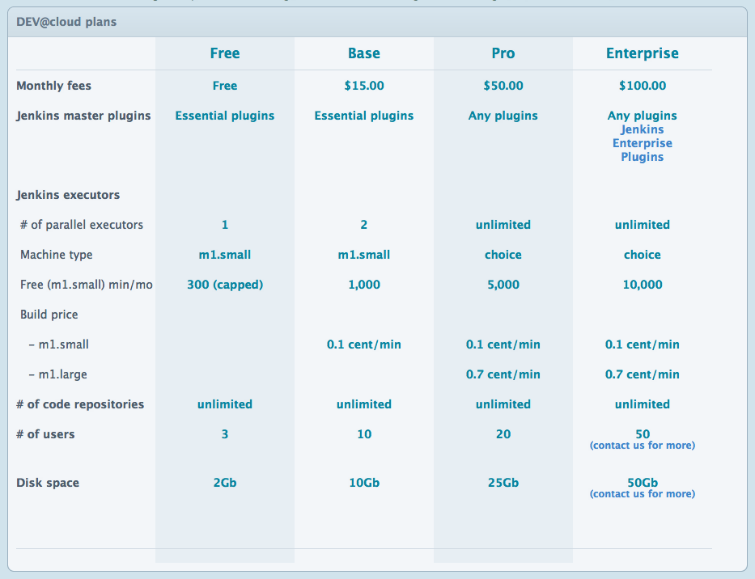
Notes:
[Title of the course]
Nov 8, 2008
Copyright © 2004-2005 NameOfTheOrganization. All rights reserved.
21

Slide 22
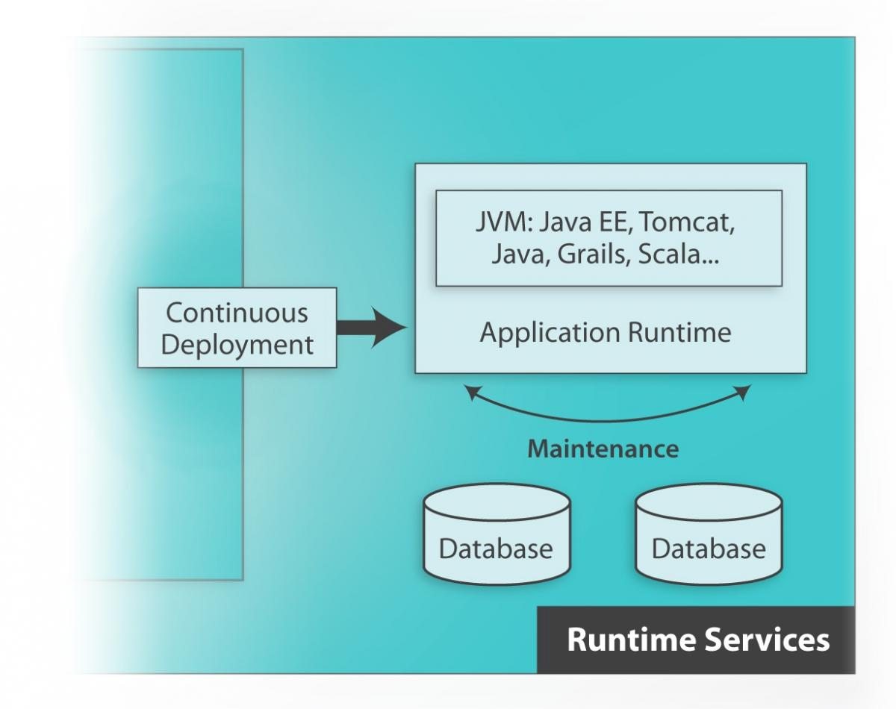
CloudBees
RUN@cloud
Allow developers to quickly and easily deploy Java applications to the cloud
Brings traditional application server functionality to the cloud
You can write software in the same way you always have…
…then deploy instantly to the cloud !
Notes:
[Title of the course]
Nov 8, 2008
Copyright © 2004-2005 NameOfTheOrganization. All rights reserved.
22
More than 4,500 applications have already been deployed on RUN@cloud's rock-solid platform

Slide 23
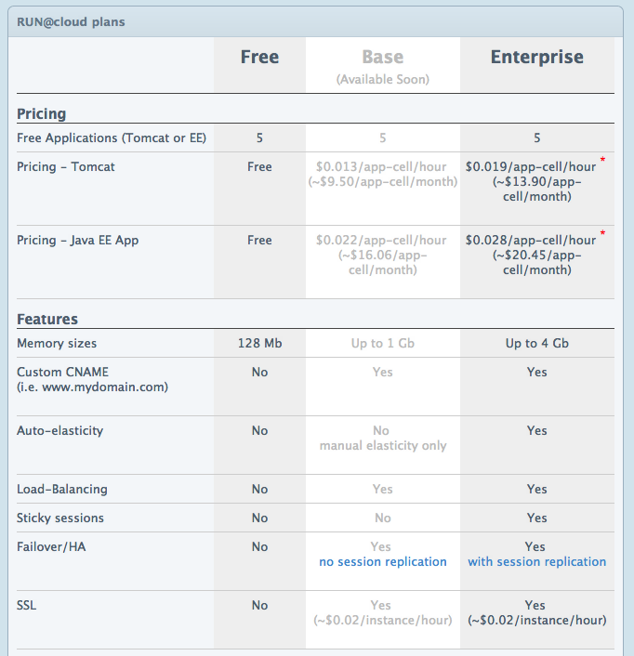
Notes:
[Title of the course]
Nov 8, 2008
Copyright © 2004-2005 NameOfTheOrganization. All rights reserved.
23

Slide 24


CloudBees
RUN@cloud - Technically…
Technically, CloudBees propose you :
Two types of Java Web container :
Basic Java Webapp
A simple Tomcat 6 server
Java EE 6 (Web Profile)
JBoss AS 7.x
Only Web Profile
No Remote EJB
No JMS
…
Only MySQL Databases
Notes:
[Title of the course]
Nov 8, 2008
Copyright © 2004-2005 NameOfTheOrganization. All rights reserved.
24
You can also have MongoDB or CouchDB as extra services

Slide 25
CloudBees
Stop-and-think
Do you have any questions ?
Notes:
[Title of the course]
Nov 8, 2008
Copyright © 2004-2005 NameOfTheOrganization. All rights reserved.
25
25

Slide 26
Exercises (1/4)
CloudBees
Create an account on CloudBees
Choose a repository type (Git or Subversion)
And push your code on CloudBees !
Create a Jenkins instance
Add a job for your project
Make the job run at each change on your repository
Make the job invoke an Ant task
Choose do-dist as target

Slide 27
Exercises (2/4)
CloudBees
But what is Ant ?
Pure Java build tool, simpler and easier to use than GNU Make
Used by NetBeans to build projects
To make the default targets work with Jenkins, you have to:
Go into <NetBeans_Folder>/java/ant/extra/
Copy the file org-netbeans-modules-java-j2seproject-copylibstask.jar
Past it into <your_project>/nbproject
Add the following property into nbproject/project.properties :
libs.CopyLibs.classpath=nbproject/org-netbeans-modules-java-j2seproject-copylibstask.jar
Notes:
http://ant.apache.org/manual/index.html

Slide 28
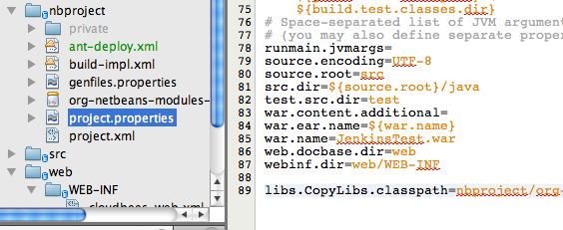
Exercises (3/4)
CloudBees

Slide 29
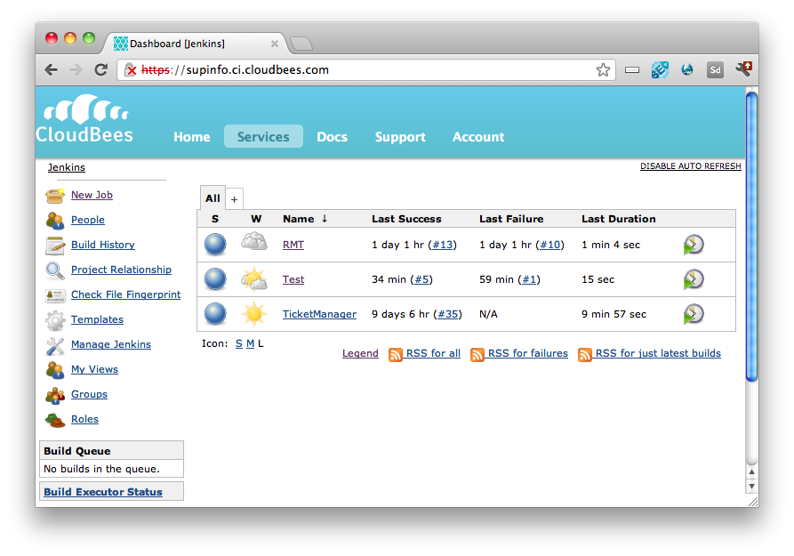
Exercises (4/4)
CloudBees

Slide 30
CloudBees SDK
CloudBees
Software Development Kit

Slide 31
CloudBees
Creating a Project
To use CloudBees, it is strongly recommended to use the CloudBees SDK
But not mandatory: you can also deploy directly your war with the web console
You can download the SDK here!
Notes:
[Title of the course]
Nov 8, 2008
Copyright © 2004-2005 NameOfTheOrganization. All rights reserved.
31
http://wiki.cloudbees.com/bin/view/RUN/BeesSDK

Slide 32
CloudBees
For Linux and Mac OS X
Unzip the SDK in a convenient director
Set the BEES_HOME environment variable
Add it to your PATH
Refresh your terminal's bash session
Verify your installation by executing the “bees” command :
export BEES_HOME=~/cloudbees-sdk-0.8.1
export PATH=$PATH:$BEES_HOME
# bees help
usage: bees <subcommand> [options] [args]
Notes:
[Title of the course]
Nov 8, 2008
Copyright © 2004-2005 NameOfTheOrganization. All rights reserved.
32
http://wiki.cloudbees.com/bin/view/RUN/BeesSDK

Slide 33
CloudBees
For Windows
CloudBees provides you a predefined Bees Console window
You just have to double click on the BEES_HOME\Bees Console icon
Avoid a path with spaces as installation directory !
Notes:
[Title of the course]
Nov 8, 2008
Copyright © 2004-2005 NameOfTheOrganization. All rights reserved.
33
http://wiki.cloudbees.com/bin/view/RUN/BeesSDK

Slide 34
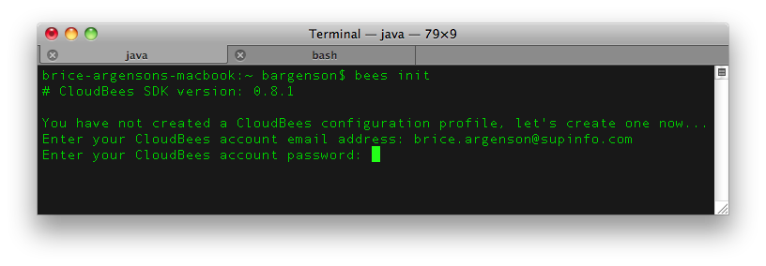
CloudBees
Configure credentials
Before continue, we need a CloudBees account
https://grandcentral.cloudbees.com/account/signup
The first thing to do with the SDK is to configure your credentials
Use the bees init command for that
Notes:
[Title of the course]
Nov 8, 2008
Copyright © 2004-2005 NameOfTheOrganization. All rights reserved.
34
http://wiki.cloudbees.com/bin/view/RUN/BeesSDK

Slide 35
CloudBees
Configure the proxy
If you are behind a proxy, you can add the following properties into your USER_HOME/.bees/bees.config file :
bees.api.proxy.host=<host>
bees.api.proxy.port=<port>
bees.api.proxy.user=<user>
bees.api.proxy.password=<password>
Notes:
[Title of the course]
Nov 8, 2008
Copyright © 2004-2005 NameOfTheOrganization. All rights reserved.
35
http://wiki.cloudbees.com/bin/view/RUN/BeesSDK

Slide 36
CloudBees
Application Service Commands
Command | Description
app:deploy [options] WAR_FILE [parameters] | Deploy a new version of an application using a WAR archive file
app:delete [options] | Delete an application
app:info [options] | Returns the basic information about an application (such as its URLs and active/sleeping state)
app:list | Returns the list of applications available to your account
app:restart [options] | Restarts all deployed instances of an application
app:tail [options] LOGNAME | Establishes a persistent connection to an application log so that you can see new messages as they are written to the logs. LOGNAME can be server, access or error
Notes:
[Title of the course]
Nov 8, 2008
Copyright © 2004-2005 NameOfTheOrganization. All rights reserved.
36

Slide 37
CloudBees
Database Service Commands
Command | Description
db:create [options] DATABASE_NAME | Create a new MySQL database
db:delete [options] DATABASE_NAME | Delete a MySQL database
db:info [options] DATABASE_NAME | Returns information about connecting to a database
db:list | Returns a list of all the databases associated with your account
db:set [options] DATABASE_NAME | Change your database password
db:snapshot:COMMAND | Manage database snapshots. COMMAND can be list, create, delete or deploy
Notes:
[Title of the course]
Nov 8, 2008
Copyright © 2004-2005 NameOfTheOrganization. All rights reserved.
37

Slide 38
CloudBees
Deploying WAR files
Before deploying WAR files
You have to place any CloudBees-specific configuration rules in a WEB-INF/cloudbees-web.xml file
<cloudbees-web-app>
<appid>myaccount/myapp</appid>
<resource name="jdbc/BEES_DB_NAME"
auth="Container" type="javax.sql.DataSource">
<param name="username" value="BEES_DB_USER" />
<param name="password" value="BEES_DB_PASS" />
<param name="url" value="BEES_DB_URL" />
</resource>
</cloudbees-web-app>
Notes:
[Title of the course]
Nov 8, 2008
Copyright © 2004-2005 NameOfTheOrganization. All rights reserved.
38

Slide 39
CloudBees
Deploying WAR files
A concrete example of cloudbees-web.xml file:
The resource name must be the same as defined in your persistence.xml file
<cloudbees-web-app>
<appid>supinfo/contactbook</appid>
<resource name="jdbc/contactbook"
auth="Container" type="javax.sql.DataSource">
<param name="username" value="plop" />
<param name="password" value="plop" />
<param name="url"
value="jdbc:mysql://[…].amazonaws.com:3306/ contactbook" />
</resource>
</cloudbees-web-app>
Notes:
[Title of the course]
Nov 8, 2008
Copyright © 2004-2005 NameOfTheOrganization. All rights reserved.
39

Slide 40
CloudBees
JSR Implementations
If you want to deploy a Java EE 6 application
Remember CloudBees use a JBoss !
To avoid problems, it is advised to use the same JSR implementations than the one using by default by the AS
JAX-RS: RESTEasy
JPA: Hibernate
Notes:
[Title of the course]
Nov 8, 2008
Copyright © 2004-2005 NameOfTheOrganization. All rights reserved.
40

Slide 41
CloudBees
Constraints - JAX-RS
For change JAX-RS implementation :
Delete the Jersey Servlet from your web.xml and replace it by :
<servlet>
<servlet-name>Resteasy</servlet-name>
<servlet-class>
org.jboss.resteasy.plugins.server.servlet.HttpServletDispatcher
</servlet-class>
</servlet>
<servlet-mapping>
<servlet-name>Resteasy</servlet-name>
<url-pattern>/rest/*</url-pattern>
</servlet-mapping>
<context-param>
<param-name>resteasy.resources</param-name>
<param-value>RESOURCE_FQDN, RESOURCE_FQDN, ...</param-value>
</context-param>
<context-param>
<param-name>resteasy.servlet.mapping.prefix</param-name>
<param-value>/rest</param-value>
</context-param>
Notes:
[Title of the course]
Nov 8, 2008
Copyright © 2004-2005 NameOfTheOrganization. All rights reserved.
41

Slide 42
CloudBees
Constraints - JPA
For change JPA implementation :
Update the provider FQDN on your persistence.xml file :
<?xml version="1.0" encoding="UTF-8"?>
<persistence version="2.0" xmlns=...>
<persistence-unit name="ContactBook-PU" transaction-type="JTA">
<provider>org.hibernate.ejb.HibernatePersistence</provider>
<jta-data-source>jdbc/contactbook</jta-data-source>
<properties>
<property name="hibernate.hbm2ddl.auto" value="update"/>
</properties>
</persistence-unit>
</persistence>
Notes:
[Title of the course]
Nov 8, 2008
Copyright © 2004-2005 NameOfTheOrganization. All rights reserved.
42

Slide 43
CloudBees
Stop-and-think
Do you have any questions ?
Notes:
[Title of the course]
Nov 8, 2008
Copyright © 2004-2005 NameOfTheOrganization. All rights reserved.
43
43

Slide 44


Exercise
CloudBees
Install the SDK on your computer
Refactor your application
Make it deployable on JBoss AS 7
Deploy your application inside the clouds !

Slide 45

Course summary
CloudBees
What is IaaS, PaaS and SaaS
Install the SDK
Use DEV@cloud
Deploy to CloudBees
Change API Implementations

Slide 46



